Slide 1
Module II (Personal protection in work environment)
Personal protection in the work environment, Types of PPEs, Personal protective equipment respiratory and non-respiratory equipment.
Standards related to PPEs.
Monitoring Safety Performance: Frequency rate, severity rate, incidence rate, activity rate.
Housekeeping: Responsibility of management and employees.
Advantages of good housekeeping.
5 s of housekeeping.
Work permit system- objectives, hot work and cold work permits.
Typical industrial models and methodology.
Entry into confined spaces.

Slide 2
Personal protection in the work environment
Personal safety in the workplace depends on your own awareness of potential threats and risks as well as your employer's safety policies and procedures.
Employers may have different priorities to consider besides your personal safety, such as losses from shoplifting, fraud against the company or the need to control costs.
By giving some thought to managing the risks, you can make yourself safer on the job.
Personal protective equipment (PPE) is protective clothing, helmets, goggles, or other garments or equipment designed to protect the wearer's body from injury or infection.

Slide 3
Personal protective equipment (PPE)
The hazards addressed by protective equipment include physical, electrical, heat, chemicals, biohazards, and airborne particulate matter.
Protective equipment may be worn for job-related occupational safety and health purposes, as well as for sports and other recreational activities.
Protective clothing is applied to traditional categories of clothing, and protective gear applies to items such as pads, guards, shields, or masks, and others.
PPE suits can be similar in appearance to a cleanroom suit.
The purpose of personal protective equipment is to reduce employee exposure to hazards when engineering controls and administrative controls are not feasible or effective to reduce these risks to acceptable levels.
PPE is needed when there are hazards present.

Slide 4
Personal protective equipment (PPE)
PPE has the serious limitation that it does not eliminate the hazard at the source and may result in employees being exposed to the hazard if the equipment fails.
Any item of PPE imposes a barrier between the wearer/user and the working environment.
This can create additional strains on the wearer, impair their ability to carry out their work, and create significant levels of discomfort.
Any of these can discourage wearers from using PPE correctly, therefore placing them at risk of injury, ill-health, or, under extreme circumstances, death.
Good ergonomic design can help to minimize these barriers and can

Slide 5
Need for PPE
Chances of failure of engineering controls, materials, process, equipment, and safety devices cannot be denied and in those circumstances, the PPE can act as a barrier between the man and the hazard and save from injury.
There are certain operations or accidental situations where engineering controls are less possible and PPE becomes necessary. For repair or maintenance or to enter into a toxic or oxygen-deficient atmosphere, or while working at height or doing jobs like welding, cutting grinding, or chipping, PPE gives good protection.
It effectively avoids the contact of dangerous substances, noise, vibration, and radiation.
It protects from atmospheric contaminants.
It is a legal as well as moral duty to provide suitable PPE.

Slide 6
Types of Personal Protective Equipment
Simple personal protective equipment
  Equipment that has a basic design model
  Protects against lower-risk hazards
  Assume that the user is aware of the hazards, can see the risk gradually increasing, and is able to make an assessment and safely identify the need for PPE to be worn.
Complex personal protective equipment
  Technical design
  Provides protection against fatal or serious risk
  User cannot identify the hazard in sufficient time and is immediately exposed to hazards that have irreversible effects.
PPE provides good defense against hazards of toxic exposure, oxygen deficiency, dusting, chemical splashes, steam, water and liquids, flying particles, hot substances, radiation, sharp edges, welding, cutting, grinding, striking against and stepping over objects, glare, personal falls, and injury due to falling bodies, noise, scarp cleaning, material handling, the opening of pipelines or any hazardous work, electric shocks, burn and firefighting

Slide 7
Types of Personal Protective Equipment
Respiratory
Non-respiratory

Slide 8
Respiratory Protective Equipment (RPE)
Used to protect the individual wearer against the inhalation of hazardous substances in the workplace air.
Employers are required to first attempt to eliminate the hazard at source.
RPE should only be used after all other reasonably practicable control measures have been taken.
PPE is considered a last resort because it only protects individual workers, is prone to failure or misuse, such as wearing the wrong RPE for the job, and employees wearing RPE may get a false sense of security when using RPE.
Respiratory Protective Equipment (RPE) not worn or selected appropriately is totally ineffective and may give the user a false sense of protection.

Slide 9
Respiratory Protective Equipment (RPE)
Respirator (filtering device)
Uses filters to remove contaminants in the workplace air, there are two main types
Non-powered respirators rely on the wearer's breathing to draw air through the filter
  Eg: Disposable filtering half mask, Half mask, full face mask
Powered respirators – use a motor to pass air through the filter to give a supply of clean air to the wearer
  Eg: Half mask, full face mask, helmets, hoods, visors
Breathing apparatus (BA) – needs a supply of breathing-quality air from an independent source (e.g. air cylinder or air compressor)

Slide 10
Respiratory Protective Equipment (RPE)
Both respirators and BA are available in a range of different styles, which can be put into two main groups:
Tight-fitting facepieces (often referred to as masks) - rely on having a good seal with the wearer’s face.
  These are available as both non-powered and powered respirators and BA.
  Examples are filtering facepieces and half and full-face masks.
Loose-fitting facepieces – rely on enough clean air being provided to the wearer to prevent contaminant leaking in (only available as powered respirators or BA). Examples are hoods helmets, visors, blouses, and suits.
WARNING: Only BA is suitable for use in oxygen-deficient atmospheres

Slide 11
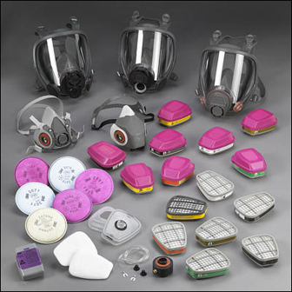
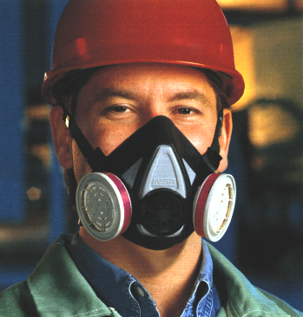
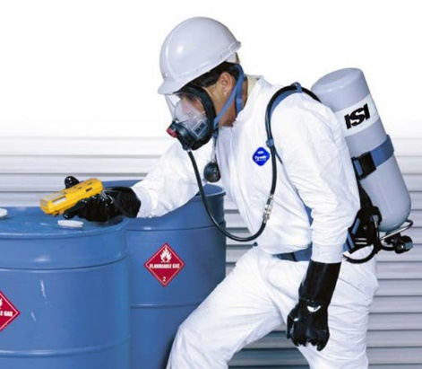
Respiratory Protective Equipment (RPE)
Source of photos: OSHA

Slide 12
Respiratory Protective Equipment (RPE)
Types of respirators
  Air-Purifying (APR) – remove contaminants from air
    Particulate respirators
    Chemical cartridge/
    gas mask respirator
    Powered Air-Purifying Respirator (PAPR)
Source of photos: OSHA
Notes:
Source: https://www.osha.gov/Publications/osha3079.pdf
“There are two major classes of respirators:
Air-purifying, which remove contaminants from the air; and
Atmosphere-supplying, which provide clean, breathable air from an uncontaminated source. As a general rule, atmosphere-supplying respirators are used for more hazardous exposures.”
Source: https://www.osha.gov/dts/shib/respiratory_protection_bulletin_2011.html
“Respirators work by either filtering particles from the air, chemically cleaning (purifying) the air, or supplying clean air from an outside source.
Particulate Respirators: Particulate respirators are the simplest, least expensive, and least protective of the respirator types available. These respirators only protect against particles (e.g., dust). They do not protect against chemicals, gases, or vapors, and are intended only for low hazard levels. The commonly known "N-95" filtering facepiece respirator or "dust mask" is one type of particulate respirator, often used in hospitals to protect against infectious agents. Particulate respirators are "air-purifying respirators" because they clean particles out of the air as you breathe.
Particulate respirators:
Filter out dusts, fumes and mists.
Are usually disposable dust masks or respirators with disposable filters.
Must be replaced when they become discolored, damaged, or clogged.
Examples: filtering facepiece or elastomeric respirator.
Chemical Cartridge/Gas Mask Respirator: Gas masks are also known as "air-purifying respirators" because they filter or clean chemical gases out of the air as you breathe. This respirator includes a facepiece or mask, and a cartridge or canister. Straps secure the facepiece to the head. The cartridge may also have a filter to remove particles.
Gas masks are effective only if used with the correct cartridge or filter (these terms are often used interchangeably) for a particular biological or chemical substance. Selecting the proper filter can be a complicated process. There are cartridges available that protect against more than one hazard, but there is no "all-in-one" cartridge that protects against all substances. It is important to know what hazards you will face in order to be certain you are choosing the right filters/cartridges.
Chemical Cartridge/Gas Mask respirator:
Uses replaceable chemical cartridges or canisters to remove the contaminant.
Are color-coded to help you select the right one.
May require more than one cartridge to protect against multiple hazards.
Powered Air-Purifying Respirator (PAPR): Powered air-purifying respirators use a fan to draw air through the filter to the user. They are easier to breathe through; however, they need a fully charged battery to work properly. They use the same type of filters/cartridges as other air-purifying respirators. It is important to know what the hazard is, and how much of it is in the air, in order to select the proper filters/cartridges.”

Slide 13
Respiratory Protective Equipment (RPE)
  Atmosphere-Supplying – provide clean, breathable air
    Self-Contained Breathing Apparatus (SCBA)
    Supplied-Air Respirator (SAR)
Source of photos: OSHA
Notes:
Source: https://www.osha.gov/Publications/osha3079.pdf
“There are two major classes of respirators:
Air-purifying, which remove contaminants from the air; and
Atmosphere-supplying, which provide clean, breathable air from an uncontaminated source. As a general rule, atmosphere-supplying respirators are used for more hazardous exposures.”
Source: https://www.osha.gov/dts/shib/respiratory_protection_bulletin_2011.html
“Self-Contained Breathing Apparatus (SCBA) is the respirator commonly used by firefighters. These use their own air tank to supply clean air, so you don't need to worry about filters. They also protect against higher concentrations of dangerous chemicals. However, they are very heavy (30 pounds or more), and require very special training on how to use and to maintain them. Also, the air tanks typically last an hour or less depending upon their rating and your breathing rate (how hard you are breathing).
Self-Contained Breathing Apparatus:
Provide clean air from a portable air tank when the air around you is simply too dangerous to breathe.
All of these respirators (except for the "dust masks" or filtering face pieces) are available in either half-mask or full-face pieces.”
Source: https://www.osha.gov/dte/library/respirators/presentation/index.html
Supplied Air Respirator (SAR)
“An atmosphere-supplying respirator for which the source of breathing air is not designed to be carried by the user. Also called airline respirator.”

Slide 14
Respiratory Protective Equipment (RPE)
Medical evaluation
  Before fit tests are conducted and employee is authorized the use of a respirator, a medical evaluation must be provide to determine the ability of the employee to use a respirator.
  Identify a physician or other license health care professional (PLHCP) to perform medical evaluations using a medical questionnaire or an initial medical evaluation with which the same information is obtained.

Slide 15
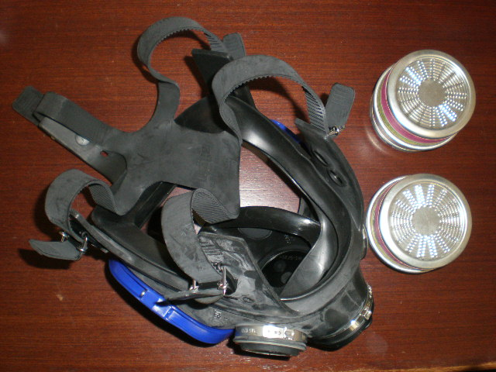
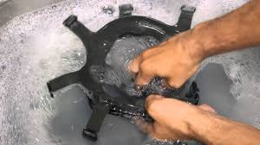
Respiratory Protective Equipment (RPE)
Inspecting and cleaning respirators
  Inspect all respirators for wear and tear before and after each use
  Wash in a detergent solution; then, disinfect by immersing in a sanitizing solution
Source of photos: Carmen Vazquez
Notes:
Source: Respiratory Protection (2002), OSHA #3079, https://www.osha.gov/Publications/OSHA3079/osha3079.html
“It is important to inspect all respirators for wear and tear before and after each use, giving special attention to rubber or plastic parts that can deteriorate or lose pliability. The facepiece, headband, valves, connecting tube, fittings, and cartridges, canisters or filters must be in good condition. A respirator inspection must include checking the tightness of the connections.
Users must inspect SCBAs at least monthly and ensure that air and oxygen cylinders are fully charged according to the manufacturer's instructions. The inspection should include a check of regulator and warning devices to ensure their proper function. Employers must keep records of inspection dates and findings.
Users should replace chemical cartridges and gas mask canisters as necessary to provide complete protection, following the manufacturer's recommendations. In addition, they should replace mechanical filters as necessary to avoid high resistance to breathing.
Only an experienced person is permitted to make repairs, using parts specifically designed for the respirator. This person must consult the manufacturer's instructions for any repair and no attempt should be made to repair or replace components or make adjustments or repairs beyond the manufacturer's recommendations.
The employer must ensure that respirators are cleaned and disinfected as often as necessary to keep them sanitary. In addition, the employer must ensure that emergency-use respirators are cleaned and disinfected immediately after each use.
Respirators should be washed in a detergent solution and then disinfected by immersing them in a sanitizing solution. Cleaner-sanitizers that effectively clean the respirator and contain a bactericidal agent are available commercially. The bactericidal agent frequently used is a quaternary ammonium compound. Strong cleaning and sanitizing agents and many solvents can damage rubber or plastic respirator parts. Use these materials with caution or after consultation with the respirator manufacturer.”

Slide 16
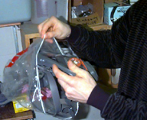
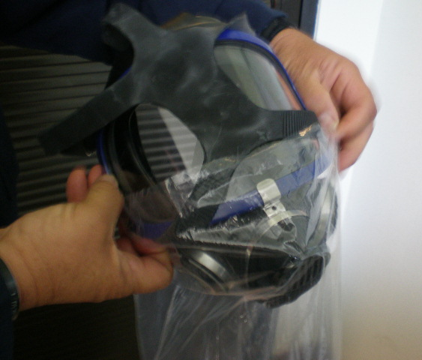
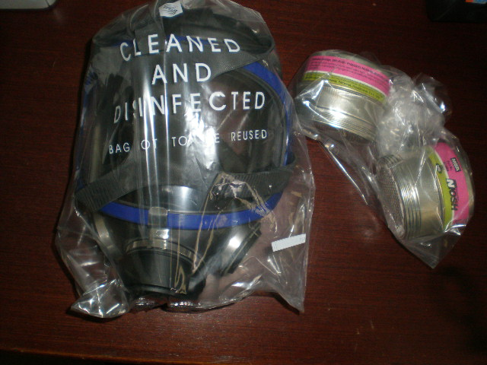
Respiratory Protective Equipment (RPE)
Storing respirators
  Protect against dust, sunlight, heat, extreme cold, excessive moisture, and damaging chemicals
  Store in position to retain natural configuration
Source of photos: Carmen Vazquez
Notes:
Source: Respiratory Protection (2002), OSHA #3079, https://www.osha.gov/Publications/OSHA3079/osha3079.html
“Users must store respirators in a way that protects them against dust, sunlight, heat, extreme cold, excessive moisture, and damaging chemicals. When packed or stored, each respirator should be positioned to retain its natural configuration. Facepieces and exhalation valves should rest in a normal position to prevent the rubber or plastic from deforming.”

Slide 17
Non Respiratory PPEs
Different types of PPE for the body and depending on the job type.
Eye protection (e.g. goggles)(RPE)
Head protection (e.g. safety helmets)
Ear protection (e.g. earplugs)
Foot protection (e.g. steel toecap boots)
Hand and arm protection (e.g. gloves)
Body protection (e.g. high-visibility clothing)
Fall protection (e.g. safety harnesses).
Skin protection (e.g. protective clothing)

Slide 18
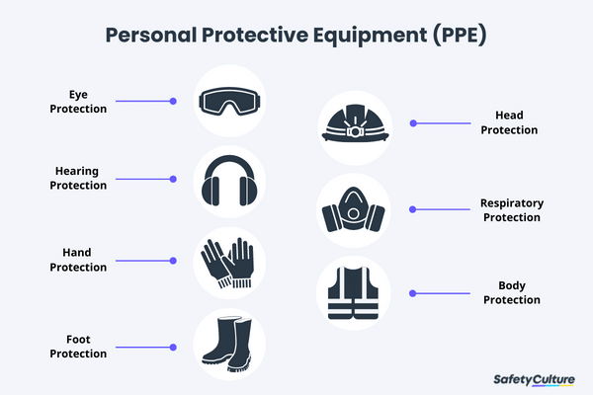

Slide 19
1. Eye Protection
These help protect the mucus membranes of the eyes, as well as help to reduce the risk of foreign objects entering the eyes and damaging them.
Needed when an employee’s work presents the potential of causing eye injury from physical, chemical, or radiation agents.
Examples of hazards:
  Machines, Lasers, Impacts, Heat, Tools, Flying Particles / Dust, Electrical work, Chemical handling
Selecting eye and face protection – elements to consider:
  Ability to protect against workplace hazards
  Should fit properly
  Should provide unrestricted vision and movement
  Durable and cleanable
  Allow unrestricted functioning of other PPE

Slide 20
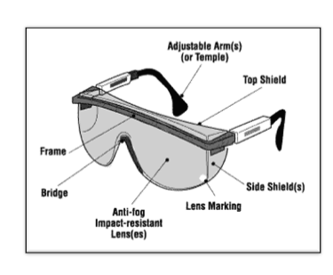
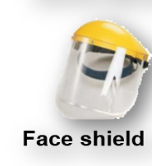
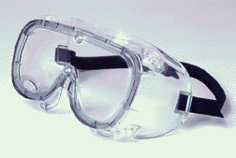
1. Eye Protection
There are three main types of eye protection, these are
  Safety glasses – These are effective for flying objects heading straight towards the face, but they are not effective for vapors and dust that can enter the eyes.
  Goggles – Protect eyes, and the facial area immediately surrounding the eyes from impact, dust, and splashes. Some can be used over corrective lenses if they fit them.
  Face shields and visors – These can be worn with prescription glasses underneath, and they help to protect the whole face.
Safety glasses Goggles

Slide 21
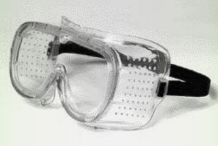
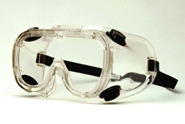
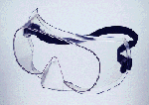
1. Eye Protection
  Goggle types
Direct-ventilated
Indirect-ventilated
Non-ventilated
Resist direct passage of large particles into the goggle
Prevents fogging by allowing air circulation
Prevents fogging by allowing air circulation
Protects against liquid or chemical splash entry
Does not allow the passage of air into the goggle
Prevents splash entry
May fog and require frequent lens cleaning
Source: OSHA.gov
Notes:
Safety goggles are used as primary protection to shield the eyes from heat hazards. Goggles form a protective seal around the eyes, preventing objects or liquids from entering under or around the goggles. This is especially important when working with or around molten metals that may splash.
When employees are exposed to high temperatures, additional protection beyond that offered by primary protectors may be required. Use safety goggles in combination with a heat-reflective face shield for severe temperatures exposure. Consider specific lens, frame, and ventilation options when selecting safety goggles.
Ventilated goggles allow air circulation while providing protection against airborne particles, dust, liquids, or light.

Slide 22
1. Eye Protection
Prescription glasses
  Employees who use prescription glasses while performing operations with
  potential eye hazards must use eye protection that:
    Incorporates the prescription in its design, or
    Can be used over your prescription glasses without interfering with the proper positioning of the prescription glasses or goggles

Slide 23
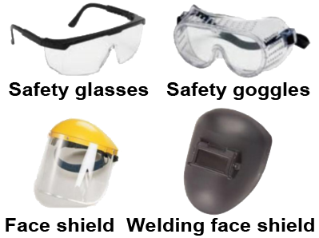
Eye and face protection
Source of images: OSHA

Slide 24

1. Eye Protection
Common causes of eye injuries
  Chemical splashes
  Blood or OPIM splashes or sprays
  Intense light
  Dust and other flying particles
  Molten metal splashes
Source: OSHA
Notes:
https://www.osha.gov/Publications/osha3151.html
OPIM is a medical abbreviation that stands for “Other Potentially Infectious Materials.”
“Employees can be exposed to a large number of hazards that pose danger to their eyes and face. OSHA requires employers to ensure that employees have appropriate eye or face protection if they are exposed to eye or face hazards from flying particles, molten metal, liquid chemicals, acids or caustic liquids, chemical gases or vapors, potentially infected material or potentially harmful light radiation.”
(OSHA Publication 3151-12R, 2003)
Examples:
Acids and other caustic liquid chemicals that might splash
Blood and other potentially infectious materials that might splash, spray
Intense light such as that created by welding and lasers
Dust and other flying particles, such as sawdust or metal shavings
Molten metal that might splash
1910.133 (b) Criteria for protective eye and face protection
Eye and face protection equipment required by this Part shall meet the requirements specified in American National Standards Institute, and devices must comply with any of the following : Z87.1-2003, ANSI Z87.1-1998 (R-1998), ANSI Z87.1-1989
Practice for Occupational and Educational Eye and Face Protection. Incorporated by reference in 1910.6

Slide 25
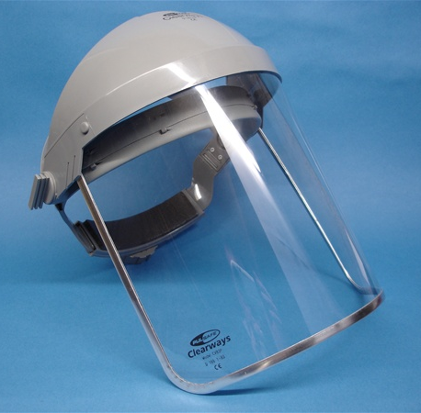
1. Eye Protection
Face shields
  Protect face from nuisance
  dusts and potential splashes
  or sprays of hazardous liquids
  Shields do not protect from
  impact hazards unless so rated
  Shields are for face protection, not eye protection. To protect the eyes, wear safety glasses with side shields, or goggles under the face shield.
Source: OSHA
Notes:
https://www.osha.gov/SLTC/etools/eyeandface/ppe/impact.html#faceshields
“Face shields are intended to protect the entire face or portions of it from impact hazards such as flying fragments, objects, large chips, and particles. When worn alone, face shields do not protect employees from impact hazards. Use face shields in combination with safety spectacles or goggles, even in the absence of dust or potential splashes, for additional protection beyond that offered by spectacles or goggles alone.”
(OSHA Eye and Face Protection eTool, 2002)

Slide 26
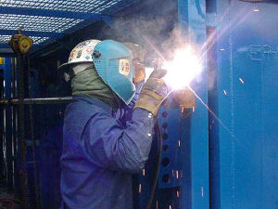
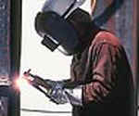
1. Eye Protection
Welding shields
  Protect eyes from burns caused by:
    Infared light
    Intense radiant light
  Protect eyes and face from flying sparks, metal spatter, and slag chips
Source of photos: OSHA
Notes:
https://www.osha.gov/Publications/osha3151.html
“Constructed of vulcanized fiber or fiberglass and fitted with a filtered lens, welding shields protect eyes from burns caused by infrared or intense radiant light; they also protect both the eyes and face from flying sparks, metal spatter, and slag chips produced during welding, brazing, soldering and cutting operations. OSHA requires filter lenses to have a shade number appropriate to protect against the specific hazards of the work being performed in order to protect against harmful light radiation.”
(OSHA Publication 3151-12R, 2003)

Slide 27
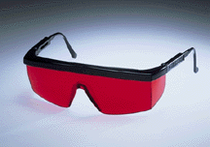
1. Eye Protection
Laser safety goggles
  Provide protection from hazards:
    physical contact such as flying particles
    ultraviolet light, laser, and welding
Source: OSHA

Slide 28
2. Head protection
Head protection can protect the head from physical hazards, they can also protect other parts of the upper body, such as the neck, hair, nose, and ears.
There are two main types of head protection that are used in the workplace, these are:
Industrial safety helmets – These protect the head from falling objects such as – tree-felling, building and construction, and blasting at a quarry.
Bump caps – These protect the head from being bumped, they are useful for maintenance personnel working under machinery and plumbers working under pipework. However, they do not offer adequate protection from the risk of a falling object.
Firefighter helmets are similar to industrial safety helmets, however, they cover more of the head and give greater protection against impact, heat and flames.

Slide 29
2. Head protection
Head Protection: Care Considerations
  Remove and replace hard hats if they have:
  Perforation, cracking, or warping of the brim or shell;
  Indication of exposure to heat, chemicals or UV light (loss of surface gloss, chalking or flaking)
  Always replace a hard hat if it sustains an impact
  Suspension can be changed if excessive wear is noticed
  Never drill holes, paint or apply labels to headgear
  Do not store headgear in the rear window shelf of a car: sunlight and extreme heat can damage them

Slide 30

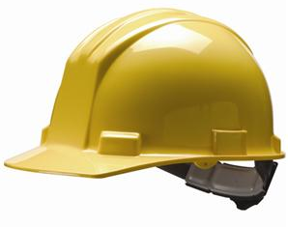
2. Head protection
Frequent causes of head injuries
  Falling objects from above striking on the head;
  Bump head against fixed objects, such as exposed pipes or beams; or
  Accidental head contact with electrical hazards.
Source: OSHA
Notes:
“Wearing a safety helmet or hard hat is one of the easiest ways to protect an employee's head from injury. Hard hats can protect employees from impact and penetration hazards as well as from electrical shock and burn hazards.
Employers must ensure that their employees wear head protection if any of the following apply:
Objects might fall from above and strike them on the head;
They might bump their heads against fixed objects, such as exposed pipes or beams; or
There is a possibility of accidental head contact with electrical hazards.”
(OSHA Publication 3151-12R, 2003)

Slide 31

2. Head protection
Why head protection is important…
Source: OSHA
Notes:
“Protecting employees from potential head injuries is a key element of any safety program. A head injury can impair an employee for life or it can be fatal.”
(OSHA Publication 3151-12R, 2003)
Your head is a very delicate part of your body. In and around your head are:
Your eyes, with which you see;
Your ears, with which you hear;
Your nose, with which you smell;
Your mouth, with which you eat and speak; and
Your brain, with which you think.
Injuries to the head are very serious. For this reason, head protection and safety are very important.

Slide 32

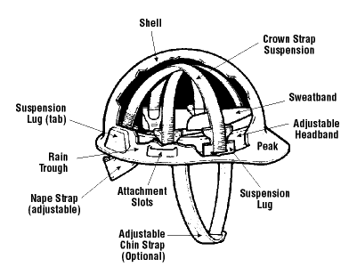
2. Head protection
Classes of hard hats:
  CLASS G (General)
    Protect against impact, penetration
    Low-voltage electrical protection (proof-tested to 2,200 volts)
Source of graphics: OSHA
Notes:
https://www.osha.gov/Publications/osha3151.html
“There are many types of hard hats available in the marketplace today. In addition to selecting protective headgear that meets ANSI standard requirements, employers should ensure that employees wear hard hats that provide appropriate protection against potential workplace hazards. It is important for employers to understand all potential hazards when making this selection, including electrical hazards. This can be done through a comprehensive hazard analysis and an awareness of the different types of protective headgear available.”
(OSHA Publication 3151-12R, 2003)
Class G hard hats are intended for general service use, such as building construction, shipbuilding, lumbering, and manufacturing. Class G hard hats provide good impact protection, but limited voltage protection (proof-tested at 2,200 volts).

Slide 33
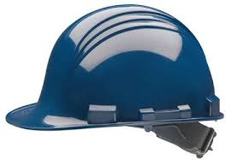
2. Head protection
  CLASS E (Electrical)
    Designed for electrical/utility work
    Protect against falling objects, impact
    Electrical protection against high-voltage
    (proof-tested to 20,000 volts)
Source: OSHA
Notes:
Class E hard hats are designed for electrical/utility work. They protect against falling objects and provide protection against conductors with higher voltage levels (proof-tested at 20,000 volts).

Slide 34

2. Head protection
  CLASS C (Conductive)
    Designed for comfort; offers limited protection
    Protects heads that may bump against fixed objects
    Does not protect against falling objects or electrical hazards
Source: OSHA
Notes:
For impact and penetration only. Usually made of aluminum, so it should not be used near areas with electrical hazards.
Class C hard hats provide limited protection, mostly from bumps against fixed objects. Class C hard hats do not provide any protection against electrical hazards.

Slide 35
3. Ear protection
Exposure to noise levels over 85 dB can cause hearing loss
Hearing protection required at 90 dB
Implement an effective Hearing Conservation Program
There are three main types of ear protection, these include:
  Ear defenders (ear muffs) – The cups are lined with sound-absorbing material, this helps to reduce the level of noise to the ears
  Earplugs – These fit into the ear canal and form a seal, they also can have a cord on them, that you can put behind the back of the neck, to help prevent them from becoming lost.
  Canal caps – These are similar to earplugs, however, they offer less protection they are suitable for operations where earplugs would be frequently taken out and put back in.

Slide 36
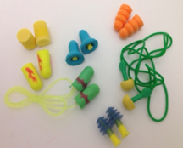
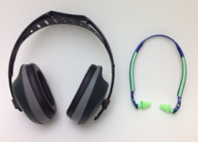
3. Ear protection
Hearing protection:
Source of photos: OSHA

Slide 37
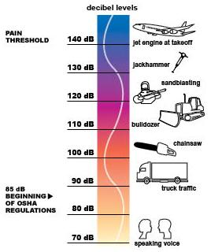
3. Ear protection
Exposure to noise levels over 85 dB can cause hearing loss
Hearing protection required at 90 dB
Implement effective Hearing Conservation Program
Source: OSHA
Notes:
https://www.osha.gov/dts/osta/otm/noise/index.html
“Noise, or unwanted sound, is one of the most common health problems in American workplaces. The National Institute for Occupational Safety and Health (NIOSH) estimates that 30 million workers in the U.S. are exposed to hazardous noise. Exposure to high levels of noise may cause hearing loss, create physical and psychological stress, reduce productivity, interfere with communication, and contribute to accidents and injuries by making it difficult to hear warning signals.
OSHA requires employers to determine if workers are exposed to excessive noise in the workplace. If so, the employers must implement feasible engineering or administrative controls to eliminate or reduce hazardous levels of noise. Where controls are not sufficient, employers must implement an effective hearing conservation program.”
(OSHA Noise and Hearing Conservation eTool, 2005)

Slide 38

3. Ear protection
Permissible Noise Exposure 29 CFR 1910.95(b)(1)
Duration per Day (hours) | Sound Level (dBA)
8 | 90
6 | 92
4 | 95
3 | 97
2 | 100
1 | 105
1/2 | 110
1/4 | 115
The employer must provide ear protection when the noise level in the work area is greater than indicated in this table.
Impact noise should not exceed 140 dB
Notes:
29 CFR 1910.95(b)(2)
“If the variations in noise level involve maxima at intervals of 1 second or less, it is to be considered continuous.
Footnote(1) When the daily noise exposure is composed of two or more periods of noise exposure of different levels, their combined effect should be considered, rather than the individual effect of each. If the sum of the following fractions: C(1)/T(1) + C(2)/T(2) C(n)/T(n) exceeds unity, then, the mixed exposure should be considered to exceed the limit value. Cn indicates the total time of exposure at a specified noise level, and Tn indicates the total time of exposure permitted at that level. Exposure to impulsive or impact noise should not exceed 140 dB peak sound pressure level.”

Slide 39
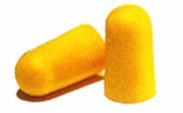
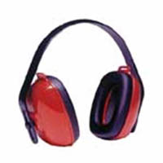
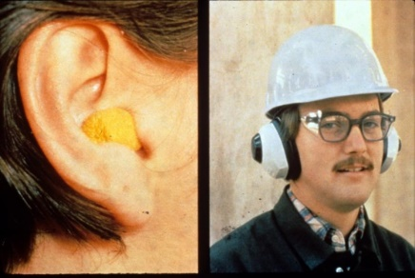
3. Ear protection
Examples of hearing protection:
  Disposable foam plugs
  Molded ear plugs
  Noise-cancelling ear plugs
  Ear muffs
Consider Noise Reduction
Rating (NRR) of devices
Source of photos: OSHA
NIOSH/John Rekus/elcosh.org
Notes:
https://www.osha.gov/dts/osta/otm/noise/index.html
“Hearing protection devices (HPDs) are considered the last option to control exposures to noise. HPDs are generally used during the necessary time it takes to implement engineering or administrative controls, or when such controls are not feasible.”
(OSHA Noise and Hearing Conservation eTool, 2005)
This slide shows some examples of hearing protection devices.
https://www.osha.gov/dts/osta/otm/new_noise/appendixe.pdf
The Noise Reduction Rating of hearing protectors is required labeling on the hearing protector package; manufacturers must identify the noise reduction capability of the product through “laboratory-derived numerical estimate of the attenuation achieved by the protector” (OSHA n.d.).

Slide 40
3. Ear protection
How to insert ear plugs properly
Source: NIOSH
Notes:
http://www-esh.fnal.gov/CourseHandout_Mat/earplug.pdf

Slide 41
4. Foot protection
There are two common types of foot protection, and they both offer a variety of protection, these are:
  Safety boots and shoes – They come with slip-resistant soles, penetration-resistant midsoles, and protective toe caps.
  Wellington boots – These are suitable for people who work in wet conditions, they are normally made from rubber, and they also come with slip-resistant soles, penetration-resistant midsoles, and protective toe caps.
Toe and foot injuries account for 5% of all disabling workplace injuries. Workers not wearing safety shoes have 75% of all occupational foot injuries.
Situations where employees should wear foot/leg protection include:
  Heavy objects such as barrels or tools might roll or fall on feet
  Sharp objects such as nails or spikes that can pierce ordinary shoes
  Exposure to molten metal that might splash on feet or legs
  Working on or around hot, wet, or slippery surfaces
  Working when electrical hazards are present

Slide 42
4. Foot protection
Safety footwear must meet ANSI minimum compression and impact performance standards in ANSI Z41-1991 (American National Standard for Personal Protection-Protective Footwear)
Foot and leg protection choices
  Leggings protect the lower legs and feet from heat hazards such as molten metal or welding sparks. Safety snaps allow leggings to be removed quickly.
  Metatarsal guards protect the instep area from impact and compression. Made of aluminum, steel, fiber, or plastic, these guards may be strapped to the outside of shoes.
  Toe guards fit over the toes of regular shoes to protect the toes from impact and compression hazards. They may be made of steel, aluminum, or plastic.
  Combination foot and shin guards protect the lower legs and feet and may be used in combination with toe guards when greater protection is needed.
  Safety shoes have impact-resistant toes and heat-resistant soles that protect the feet against hot work surfaces common in roofing, paving, and hot metal industries. The metal insoles in some safety shoes protect against puncture wounds.

Slide 43
4. Foot protection
Special Purpose Shoes
  Safety shoes may also be designed to be electrically conductive to prevent the buildup of static electricity in areas with the potential for explosive atmospheres or nonconductive to protect workers from workplace electrical hazards.
  Electrically conductive shoes provide protection against the buildup of static electricity. Workers in explosive and hazardous locations such as explosives manufacturing facilities or grain elevators must wear conductive shoes to reduce the risk of static electricity buildup.
  Electrical hazard, safety-toe shoes are nonconductive and will prevent the wearers’ feet from completing an electrical circuit to the ground. These shoes can protect against open circuits of up to 600 volts in dry conditions.
  Foundry Shoes insulate the feet from extreme heat and keep hot metal from lodging in shoe eyelets, tongues or other shoe parts.

Slide 44
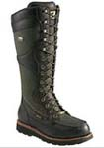
4. Foot and leg protection
Causes of foot injuries:
  Falling or rolling of heavy objects
  Crushing or penetrating materials
  Sharp objects that can penetrate
  the sole
  Exposure to molten metal
  Working on, or around, hot, wet, or slippery surfaces
  Working when electrical
  hazards are present.
  Source: OSHA
Notes:
Employees who face possible foot or leg injuries from falling or rolling objects or from crushing or penetrating materials should wear protective footwear. Also, employees whose work involves exposure to hot substances or corrosive or poisonous materials must have protective gear to cover exposed body parts, including legs and feet….
Examples of situations in which an employee should wear foot and/or leg protection include:
When heavy objects such as barrels or tools might roll onto or fall on the employee's feet;
Working with sharp objects such as nails or spikes that could pierce the soles or uppers of ordinary shoes;
Exposure to molten metal that might splash on feet or legs;
Working on or around hot, wet, or slippery surfaces; and
Working when electrical hazards are present.”
(OSHA Publication 3151-12R, 2003)

Slide 45
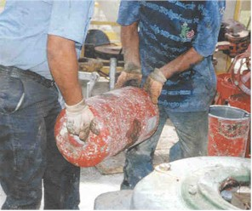
4. Foot and leg protection
Conditions requiring foot protection
  Impacts
  Compressions
  Cuts/punctures
  Chemicals
  Temperatures
  Source: OSHA
Notes:
IMPACTS – loading or handling materials such as packages, equipment or heavy objects that could fall
COMPRESSIONS – activities involving vehicles (manual material handling carts)
CUTS/PUNCTURES – sharp objects such as nails, wire, tacks, staples, screws, scrap metal
CHEMICALS – verify with your supervisor and/or the SDS (Safety Data Sheet) for adequate protection
TEMPERATURES – extreme hot or cold work surfaces and/or materials

Slide 46
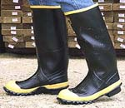
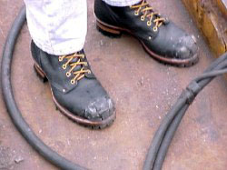
4. Foot and leg protection
Examples of foot and leg protection
  Impact-resistant toe and/or instep
    Steel
    Composite
  Heat-resistant soles
  Metal shanks
  Specialty footwear may be needed
    Metatarsal guards
    Liquid- or chemical-resistant
    Conductive or nonconductive
Source of photos: OSHA
Notes:
https://www.osha.gov/Publications/osha3151.html
“Safety shoes have impact-resistant toes and heat-resistant soles that protect the feet against hot work surfaces common in roofing, paving and hot metal industries. The metal insoles of some safety shoes protect against puncture wounds. Safety shoes may also be designed to be electrically conductive to prevent the buildup of static electricity in areas with the potential for explosive atmospheres or nonconductive to protect workers from workplace electrical hazards.”
“Metatarsal guards protect the instep area from impact and compression. Made of aluminum, steel, fiber or plastic, these guards may be strapped to the outside of shoes.”
“Electrically conductive shoes provide protection against the buildup of static electricity…. Employees exposed to electrical hazards must never wear conductive shoes.”
“Electrical hazard, safety-toe shoes are nonconductive and will prevent the wearers' feet from completing an electrical circuit to the ground. These shoes can protect against open circuits of up to 600 volts in dry conditions and should be used in conjunction with other insulating equipment and additional precautions to reduce the risk of a worker becoming a path for hazardous electrical energy. The insulating protection of electrical hazard, safety-toe shoes may be compromised if the shoes become wet, the soles are worn through, metal particles become embedded in the sole or heel, or workers touch conductive, grounded items. Note: Nonconductive footwear must not be used in explosive or hazardous locations.”
(OSHA Publication 3151-12R, 2003)

Slide 47
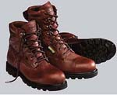

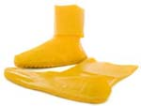
4. Foot and leg protection
Protection from hazards
  Shoes with metal toe-cap protects against knocks, falling objects
  Rubber shoes protect against chemical materials, as directed
  by the SDS
Source of photos: OSHA

Slide 48
5. Hand and arm protection
Hand and finger injuries account for 18% of all disabling injuries and about 25% of all industrial workplace accidents
Some factors that influence the selection of protective gloves:
  Type of chemicals handled.
  Nature of contact (total immersion, splash, etc.).
  Duration of contact.
  Area requiring protection (hand only, forearm, arm).
  Grip requirements (dry, wet, oily).
  Thermal protection.
  Size and comfort.
  Abrasion/resistance requirements.
Glove materials fall into 4 groups
  Leather, canvas, or metal mesh
  Fabric and coated fabric gloves
  Chemical- and liquid-resistant gloves
  Insulating rubber gloves

Slide 49
5. Hand and arm protection
There are four main types of hand and arm protection, these include:
  Gloves – These protect the hands, they can prevent blisters from occurring, and people from burning themselves or getting splinters in their hands.
  Gloves with cuffs – These protect both the hand and the wrists
  Gauntlets, sleeves, and long gloves – These provide protection for the hands, wrists, and parts of the forearms.
  Sleeves and arm protection – These can provide protection for the whole forearms and upper arms.

Slide 50
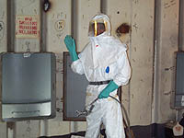
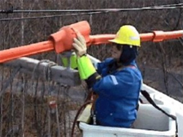
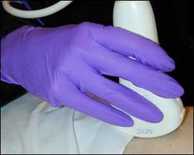
5. Hand and arm protection
Potential hazards for hands
  Skin absorption of hazardous substances
  Lacerations or severe cuts
  Punctures
  Chemical burns
  Thermal burns
  Extreme temperatures
Source of photos: OSHA
Notes:
The employer select and require employees the proper use of hand protection when exposed to hazards.

Slide 51

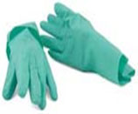
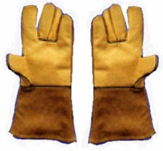
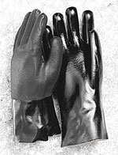
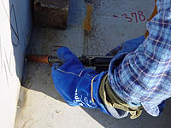
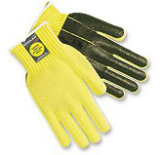
5. Hand and arm protection
Types of gloves
Anti-vibration
Chemical-resistant
Leather Palm
Heat-resistant
Cut-resistant
Permeation-resistant
Source of photos: OSHA
Notes:
https://www.osha.gov/Publications/osha3151.html
“There are many types of gloves available today to protect against a wide variety of hazards. The nature of the hazard and the operation involved will affect the selection of gloves. The variety of potential occupational hand injuries makes selecting the right pair of gloves challenging. It is essential that employees use gloves specifically designed for the hazards and tasks found in their workplace because gloves designed for one function may not protect against a different function even though they may appear to be an appropriate protective device.
The following are examples of some factors that may influence the selection of protective gloves for a workplace.
Type of chemicals handled.
Nature of contact (total immersion, splash, etc.).
Duration of contact.
Area requiring protection (hand only, forearm, arm).
Grip requirements (dry, wet, oily).
Thermal protection.
Size and comfort.
Abrasion/resistance requirements.
Gloves made from a wide variety of materials are designed for many types of workplace hazards. In general, gloves fall into four groups:
Gloves made of leather, canvas or metal mesh;
Fabric and coated fabric gloves;
Chemical- and liquid-resistant gloves;
Insulating rubber gloves”
(OSHA Publication 3151-12R, 2003)

Slide 52
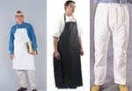
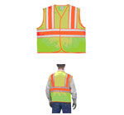
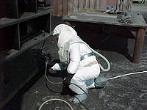
6. Body protection
protective clothing
Source of photos: OSHA

Slide 53
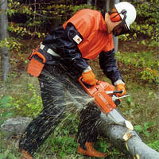
6. Body protection
Provide protective clothing for those parts of the body exposed to possible injuries
Types of body protection
  Laboratory coats
  Coveralls
  Vests
  Jackets
  Aprons
  Surgical gowns
  Full-body suits
Source of photos: OSHA
Notes:
Source: Personal Protective Equipment (2003), OSHA #3151-12R, https://www.osha.gov/Publications/osha3151.html#bodyprotection
“Employees who face possible bodily injury of any kind that cannot be eliminated through engineering, work practice or administrative controls, must wear appropriate body protection while performing their jobs. In addition to cuts and radiation, the following are examples of workplace hazards that could cause bodily injury:
Temperature extremes;
Hot splashes from molten metals and other hot liquids;
Potential impacts from tools, machinery and materials;
Hazardous chemicals.
There are many varieties of protective clothing available for specific hazards. Employers are required to ensure that their employees wear personal protective equipment only for the parts of the body exposed to possible injury. Examples of body protection include laboratory coats, coveralls, vests, jackets, aprons, surgical gowns and full body suits.”

Slide 54

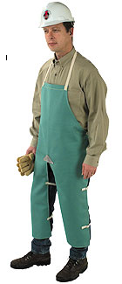
6. Body protection
Selection of body protection – variety of materials effective against particular hazard
  Paper-like fiber – dust and splashes
  Treated wool and cotton – fire-resistant; dust, abrasions, rough/irritating surfaces
  Duck – cuts, bruises
  Leather – dry heat, flames
  Rubber, rubberized fabrics, neoprene, and plastics – certain chemicals and physical hazards
Source of photos: OSHA
Notes:
Source: Personal Protective Equipment (2003), OSHA #3151-12R, https://www.osha.gov/Publications/osha3151.html#bodyprotection
“Protective clothing comes in a variety of materials, each effective against particular hazards, such as:
Paper-like fiber used for disposable suits provide protection against dust and splashes.
Treated wool and cotton adapts well to changing temperatures, is comfortable, and fire-resistant and protects against dust, abrasions and rough and irritating surfaces.
Duck is a closely woven cotton fabric that protects against cuts and bruises when handling heavy, sharp or rough materials.
Leather is often used to protect against dry heat and flames.
Rubber, rubberized fabrics, neoprene and plastics protect against certain chemicals and physical hazards. When chemical or physical hazards are present, check with the clothing manufacturer to ensure that the material selected will provide protection against the specific hazard.”

Slide 55
6. Body protection
Protective clothing is required for HAZWOPER activities
EPA’s levels of PPE
  Level A
    Provides highest level of protection
    Required when greatest potential for exposure exists and greatest level of skin, respiratory, and eye protection is required
    Examples
      Positive pressure, full facepiece SCBA, or positive pressure supplied air respirator with escape SCBA
      Totally encapsulated chemical- and vapor-protective suit
      Inner and outer chemical-resistant gloves
      Disposable protective suit, gloves, and boots
Notes:
See OSHA Technical Manual, section VIII, Cap 1 for protective clothing required for HAZWOPER activities.
Source: Personal Protective Equipment (n.d.), Environmental Protection Agency,
https://www.epa.gov/emergency-response/personal-protective-equipment
“Vapors, gases, and particulates from hazardous substance response activities place response personnel at risk. For this reason, response personnel must wear appropriate personal protective clothing and equipment whenever they are near the site. The more that is known about the hazards at a release site, the easier it becomes to select personal protective equipment. There are four levels of personal protective equipment…
While these [the following] are general guidelines for typical equipment to be used in certain circumstances, other combinations of protective equipment may be more appropriate, depending upon specific site characteristics.”
“Level A protection is required when the greatest potential for exposure to hazards exists, and when the greatest level of skin, respiratory, and eye protection is required. Examples of Level A clothing and equipment include:
positive pressure, full face-piece self contained breathing apparatus (SCBA) or positive pressure supplied air respirator with escape SCBA;
totally encapsulated chemical- and vapor-protective suit;
inner and outer chemical-resistant gloves; and
disposable protective suit, gloves, and boots.”

Slide 56
6. Body protection
  Level B
    Required for highest level of respiratory protection and lesser level of skin protection
    Examples
      Positive pressure, full facepiece SCBA, or positive pressure supplied air respirator with escape SCBA
      Inner and outer chemical-resistant gloves
      Face shield
      Hooded chemical-resistant clothing
      Coveralls
      Outer chemical-resistant boots
Notes:
Source: Personal Protective Equipment (n.d.), Environmental Protection Agency,
https://www.epa.gov/emergency-response/personal-protective-equipment
“Level B protection is required under circumstances requiring the highest level of respiratory protection, with lesser level of skin protection. At most abandoned outdoor hazardous waste sites, ambient atmospheric vapors or gas levels have not approached sufficiently high concentrations to warrant level A protection. Examples of Level B protection include:
positive pressure, full face-piece self contained breathing apparatus (SCBA) or positive pressure supplied air respirator with escape SCBA;
inner and outer chemical-resistant gloves;
face shield;
hooded chemical resistant clothing;
coveralls; and
outer chemical-resistant boots.”

Slide 57
6. Body protection
  Level C
    Required when concentration and type of airborne substances are known and criteria for using APR is met
    Examples
      Full-face air-purifying respirators
      Inner and outer chemical-resistant gloves
      Hard hat
      Escape mask
      Disposable chemical-resistant outer boots
Notes:
Source: Personal Protective Equipment (n.d.), Environmental Protection Agency,
https://www.epa.gov/emergency-response/personal-protective-equipment
“Level C protection is required when the concentration and type of airborne substances is known and the criteria for using air purifying respirators is met. Typical Level C equipment includes:
full-face air purifying respirators;
inner and outer chemical-resistant gloves;
hard hat;
escape mask; and
disposable chemical-resistant outer boots.”

Slide 58
6. Body protection
  Level D
    Required when minimum protection is needed
    Sufficient when no contaminants are present or work operations preclude splashes, immersion, or potential for unexpected inhalation or contact
    Examples
      Gloves
      Coveralls
      Safety glasses
      Face shield
      Chemical-resistant, steel-toe boots or shoes
Notes:
Source: Personal Protective Equipment (n.d.), Environmental Protection Agency,
https://www.epa.gov/emergency-response/personal-protective-equipment
“Level D protection is the minimum protection required. Level D protection may be sufficient when no contaminants are present or work operations preclude splashes, immersion, or the potential for unexpected inhalation or contact with hazardous levels of chemicals. Appropriate Level D protective equipment may include:
gloves;
coveralls;
safety glasses;
face shield; and
chemical-resistant, steel-toe boots or shoes.”

Slide 59
7. Fall protection systems
These can be used by individuals when they are working at height, and they can wear the harness, there are two main types of fall protection systems, these include:
  Work restraint systems – These prevent the user from reaching zones where the risk of a fall exists, this means they will be protected from falling and hurting themselves
  Work positioning systems – These are similar to work restraint systems and allow the user to have both hands for working. If using this system, you must always have a back up system in place.

Slide 60
8. Skin protection
Types of skin protection
There are three main types of whole-body skin protection
  Separates – these only cover part of the body (e.g. jackets or trousers).
  Aprons – these only cover part of the body.
  Overalls, coveralls, body suits, boiler suits, and chemical suits – these cover the whole body, and may be reusable or disposable.
For leg protection (as well as trousers), there is also;
  Knee pads.
  Gaiters – these cover the shins.
  Hard fibre or metal guards, which help to protect against some impact hazards.

Slide 61
8. Skin protection
For skin protection to be effective;
  Protective clothing must be suitable for the hazard (e.g. chemical resistance and protection against physical hazards can vary widely).
  Manufacturer’s instructions must be followed (e.g. do not use chemical resistance for longer than the recommended breakthrough times, and clean as to not damage its effectiveness).
  Worn or contaminated clothing must be stored separately from clean clothing.
  Check for surface damage, which could reduce its effectiveness.
  Do not wear loose clothing near moving machinery, if there is a chance that it could get caught.

Slide 62
8. Skin protection
High visibility clothing
This is required to protect the body against certain hazards such as moving vehicles, the main types are:
  Jackets
  Tops
  Trousers
  Vests

